Slide 1

Airbnb- New York City
Asavari Kale
Bhagyashri Badgujar
Kshitija Sankhe
Rujuta Tamhankar
Saira Gurung
Business Intelligence & Data Warehousing

Slide 2
Contents
Business Overview
Business Analysis
Lead and Lag Measures
Data Model Design
ETL Process
Data Analysis and Demo (Tableau visualization)
Assumptions
Insights
Dashboards
Notes:
We can add this information in table

Slide 3

Business Overview
San Francisco based company
Online platform that acts as a broker for people to offer and acquire lodgings, as well as tourism experiences
Commission
Not an owner of the properties
Most expensive city to live in the US
State law did not allow most Airbnb types in NYC

Slide 4
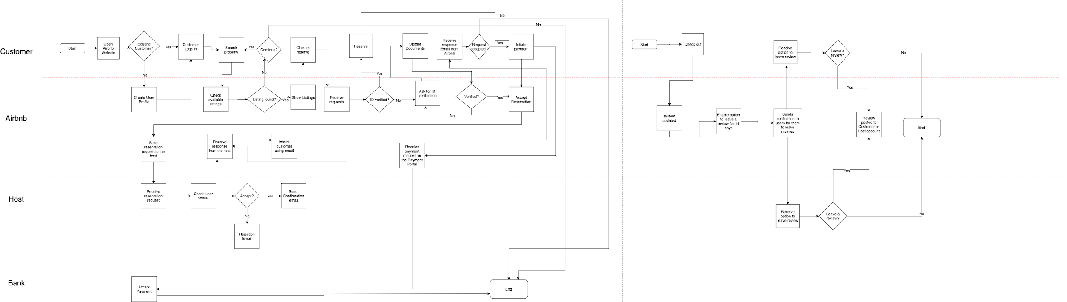
Swimlane depicting Business Processes
Notes:
Main transaction

Slide 5
Business Analysis
Aim to analyze the business trends pertaining to accomadation industry in New York City
Tool for potential hosts
Utilizing different data sources to evaluate measures from different perspective
Foster growth of alike businesses in the market
Notes:
summarize

Slide 6
Lag measures
Revenue per neighborhood group
Revenue per room type
Revenue per holiday and non holiday season
Top neighborhood by no. of host for each neighborhood group
Cheapest property per neighborhood group by room type
Cheapest property per neighborhood group by price range
Notes:
After the business analysis and deciding upon the data we moved ahead with measures. We came up with some lead measures and lag measures

Slide 7
Lead Measures
Revenue by neighborhood group per month
Estimated revenue forecast per month per neighborhood group

Slide 8
Data Model Designing
Creation of OLTP and ODS schema

Slide 9
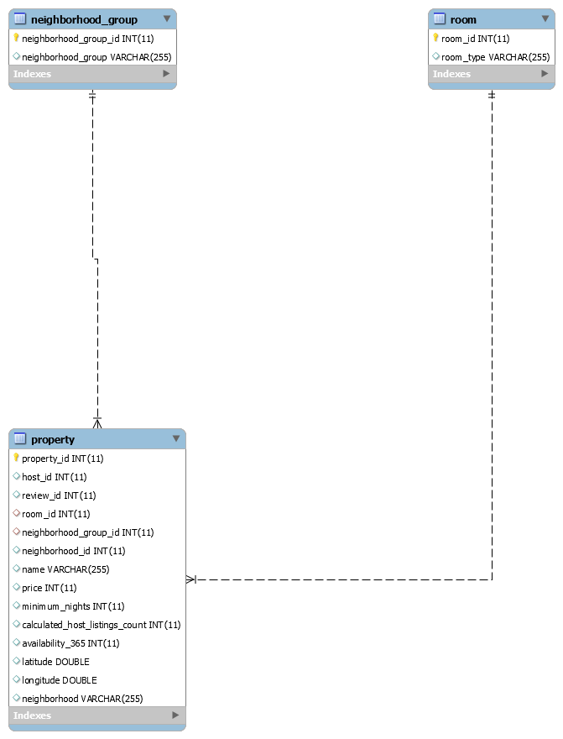
OLTP Schema
Tables in OLTP database: 1) neighborhood_group
2) property 3) room
Notes:
We had an SQL database and after processing and cleaning data we came up with 3 tables.

Slide 10
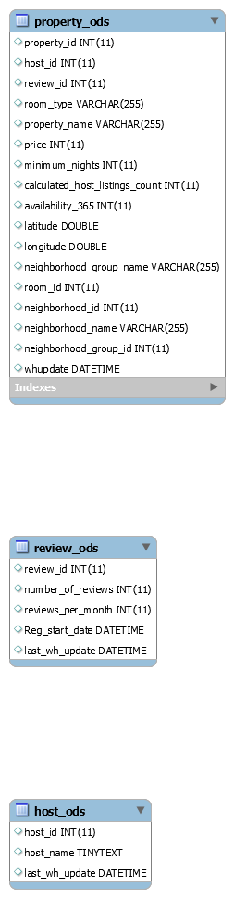
ODS Schema
Tables in ODS database: 1) property_ods
2) review_ods 3) host_ods
Notes:
We can add snippet of tables from ODS schema in this slide. Kshitija

Slide 11
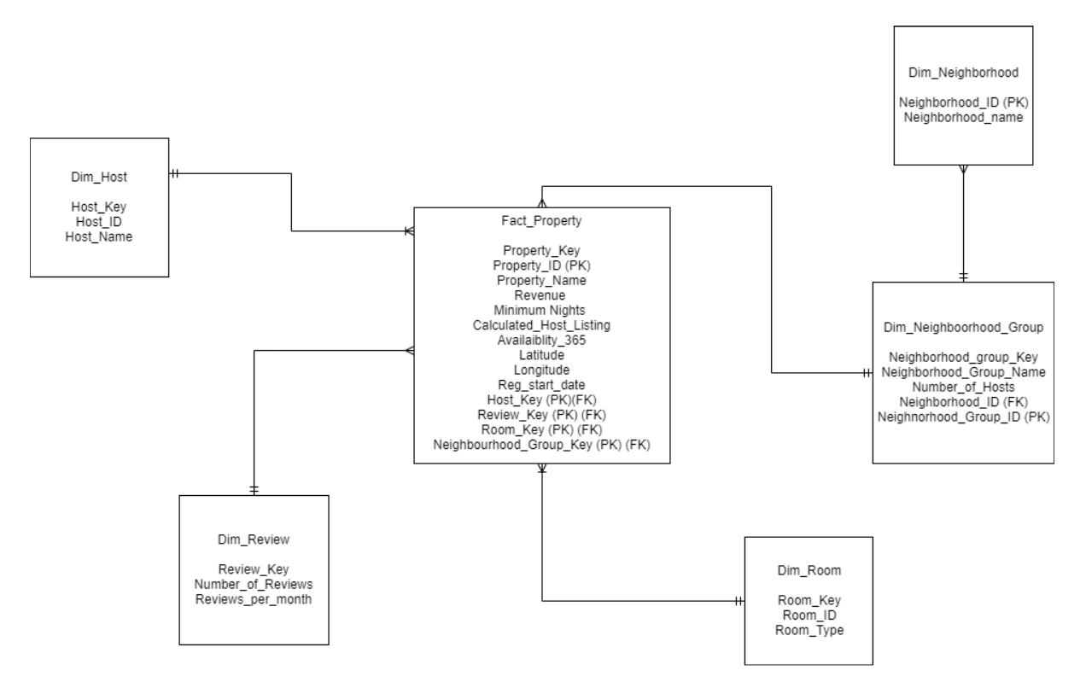
Data Warehouse Snowflake Schema
Notes:
Kshitija add (property_name_

Slide 12
ETL Process
Different data sources we used : existing database and csv files. Data source: https://www.kaggle.com/dgomonov/new-york-city-airbnb-open-data#AB_NYC_2019.csv
KTR transformations were created to build ODS database. We used different data sources like existing OLTP database and excel files to build ODS database.
ETL job was created to join all the KTR transformations to build the data warehouse.
Notes:
Kshitija: 1) one of the Data source was existing database and csv files using which we built ODS schema

Slide 13
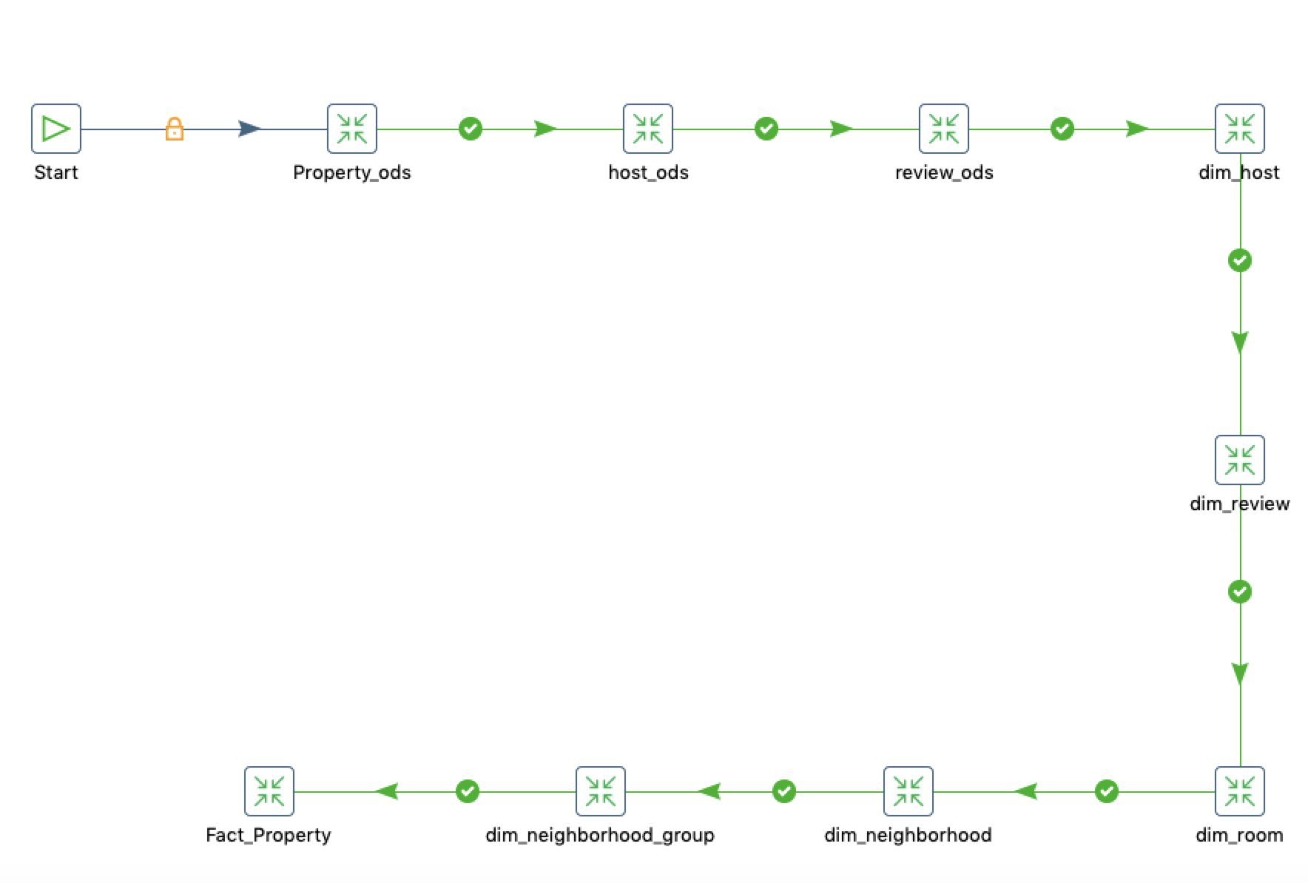
ETL Job

Slide 14
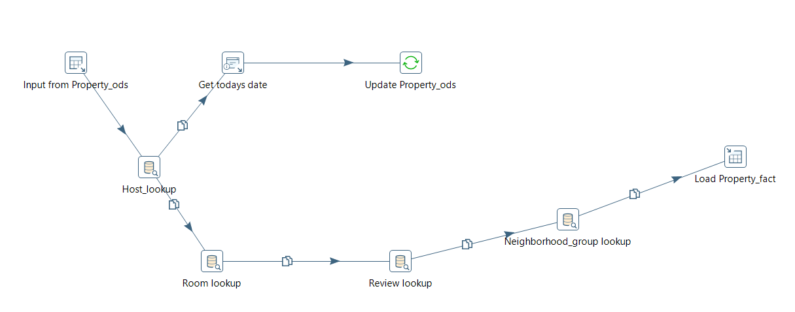
Fact_Property transformation

Slide 15
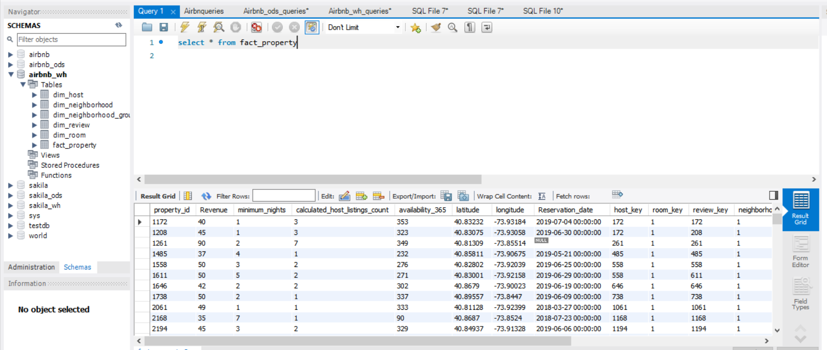
Snippet of Fact table-1
Notes:
rujuta

Slide 16
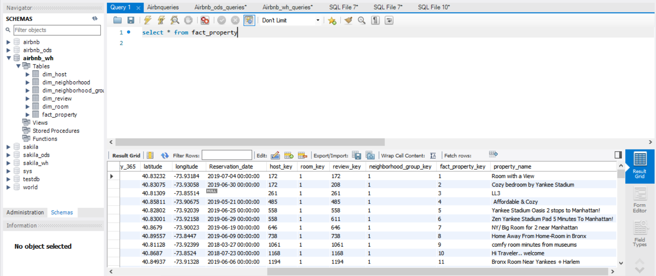
Snippet of Fact table-2

Slide 17
Data Visualization using Tableau
Data Analysis and Visualization

Slide 18
Data Assumptions
In the column of number of reviews, all the reviews were considered to be positive.
Holiday season is considered for the months of May, June, July, August, December, January.
Non-Holiday season is considered for the months of February, March, April, September, October, November.
The revenue is calculated based on the field ‘price per night’ and it is assumed that the property is occupied for 1 night.
Notes:
Bhagyashri

Slide 19
Insights
What price range contains most number of Airbnb properties?
Most number of Airbnb properties belongs to the price range of $50 - $100.
What is the pattern of the revenue over the period from 2011 to 2018?
Revenue of Airbnb kept on gradually increasing over a period of time from 2011 to 2018
What are the top 10 neighborhoods wrt each neighborhood group containing the maximum number of hosts?
Woodside contains most number of hosts in its area which are around 4554, next being Sunnyside with a count of 2542 hosts in its area.

Slide 20
Insights
Which neighborhood group grossed the highest revenue over the period from 2011 to 2018?
Manhattan has the highest gross revenue collection of 4.26M
Which are the most economical properties within a particular neighborhood group in NY considering the price range and room type?
Couch in Harlem Harvey Refugees is the most economical place.

Slide 21
Dashboard 1:Descriptive Analysis
Stakeholder: Customer/Host
Top 10 neighborhoods were found in each neighborhood group to find out if they want to buy place to rent out to Airbnb or rent a place to Airbnb which area contains more number of host.
Cheapest properties within the price range as per the room type depicted from customer’s perspective to find out the best room possible in the selected neighborhood
Dashboard allows you to find according to which neighborhood which one contains most number of host and helps the customer to find out the cheapest airbnb available.
Notes:
Bhagyashri

Slide 22
Dashboard 2: Predictive Analysis
Stakeholder - Airbnb.
A prediction of the revenue forecast is done for the year of 2019 to using the revenue collection data from 2011 to 2018.
Two sets : Holiday Season, Non-Holiday Seasons
Prediction done of revenue actually collected and revised revenue collected by changing the percentage of host renting their property and change in price per night filtered on the type of room.
Dashboard depicts the revenue forecast per neighborhood group and change in it based on holiday and non-holiday season with respect to the room type available.
Notes:
The Stakeholder here we have considered id Airbnb.
In the first part of the dashboard we have tried to do a …
For the second part of the dashboard, we have used two sets known as holiday and non-holiday season.
To summarize these to parts this dashboard

Slide 23
Reference Tableau Screenshots

Slide 24
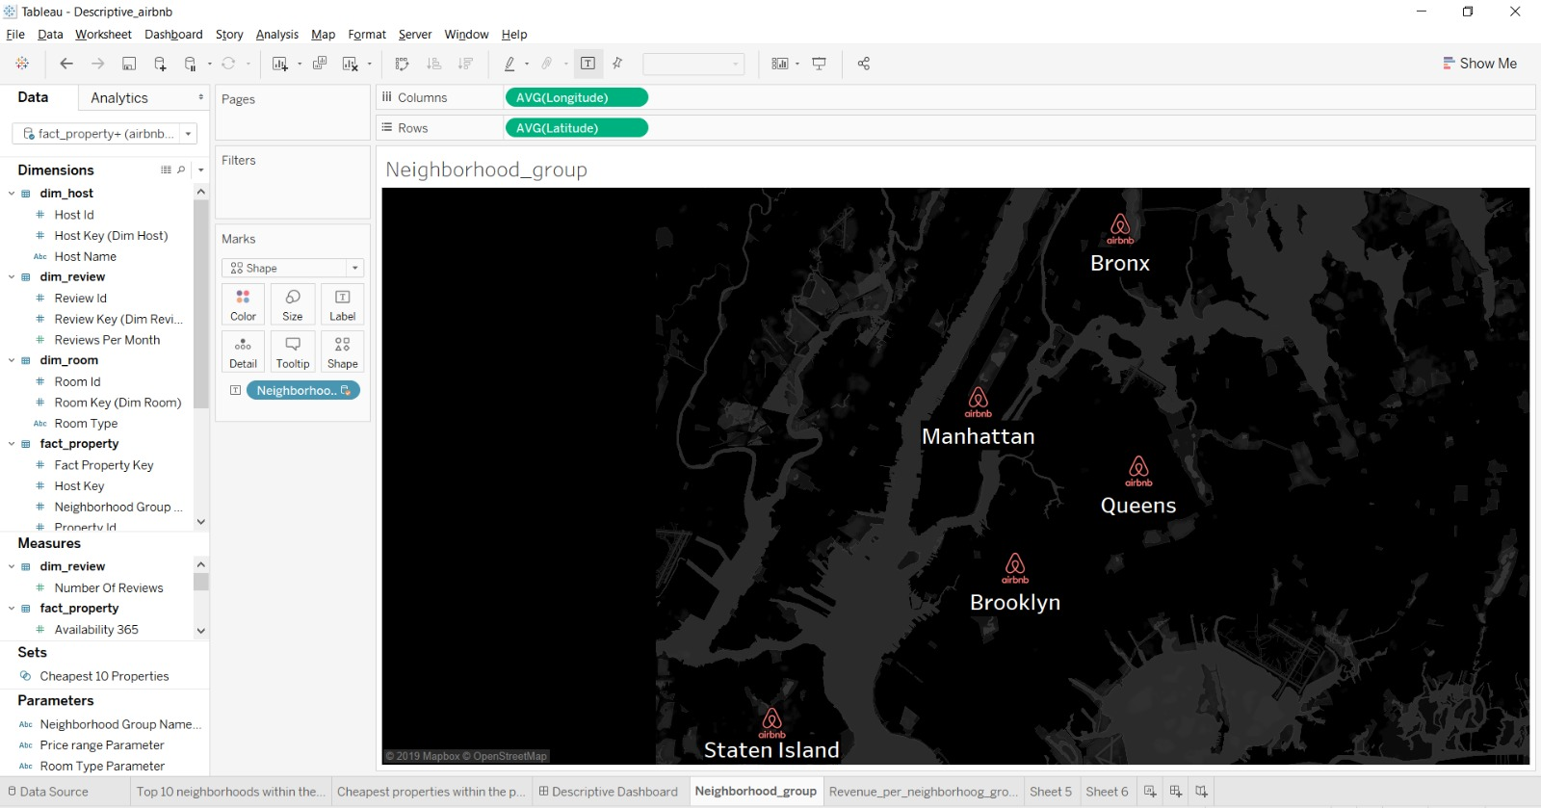

Slide 25
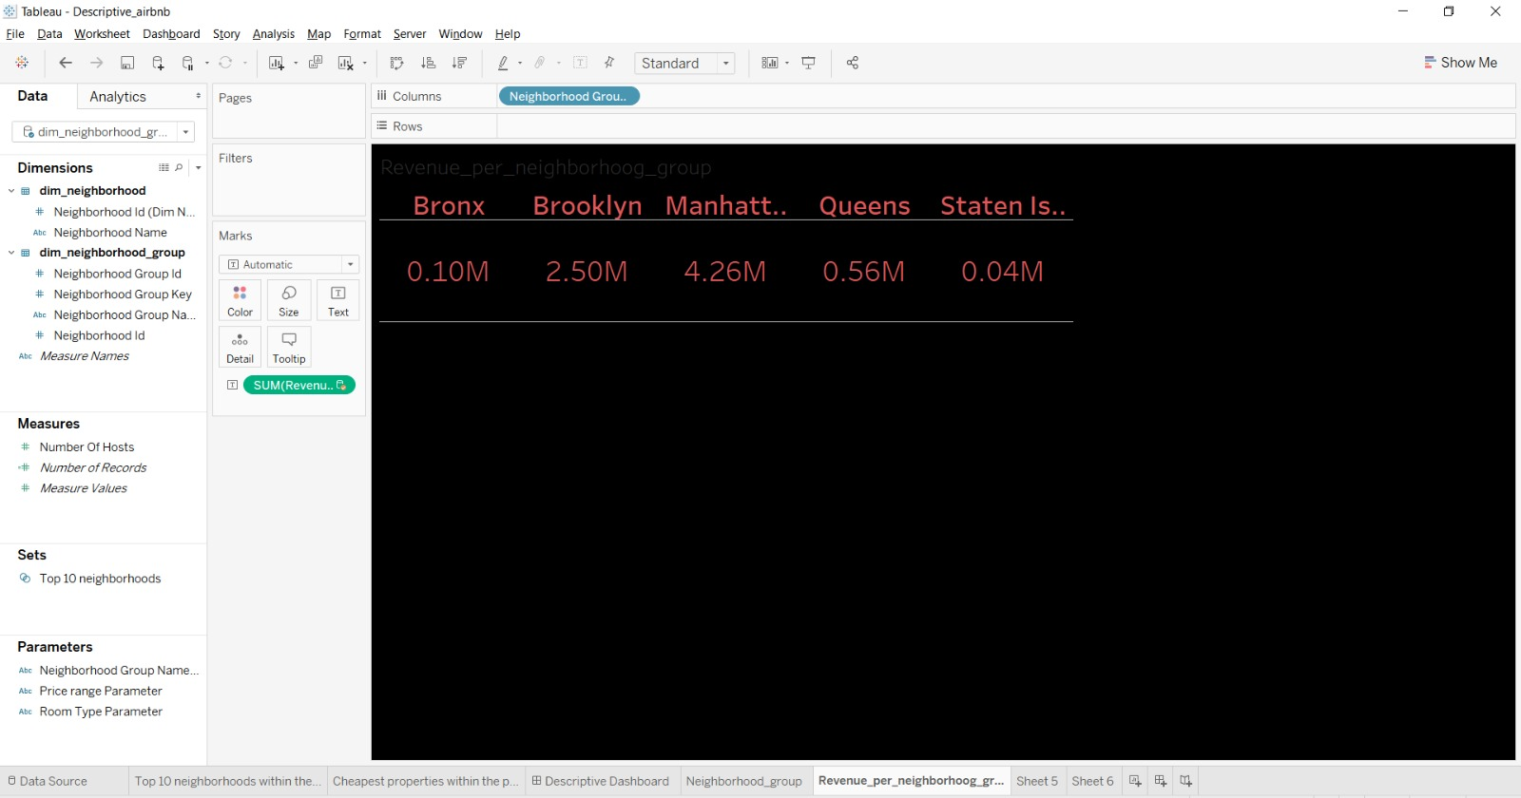

Slide 26
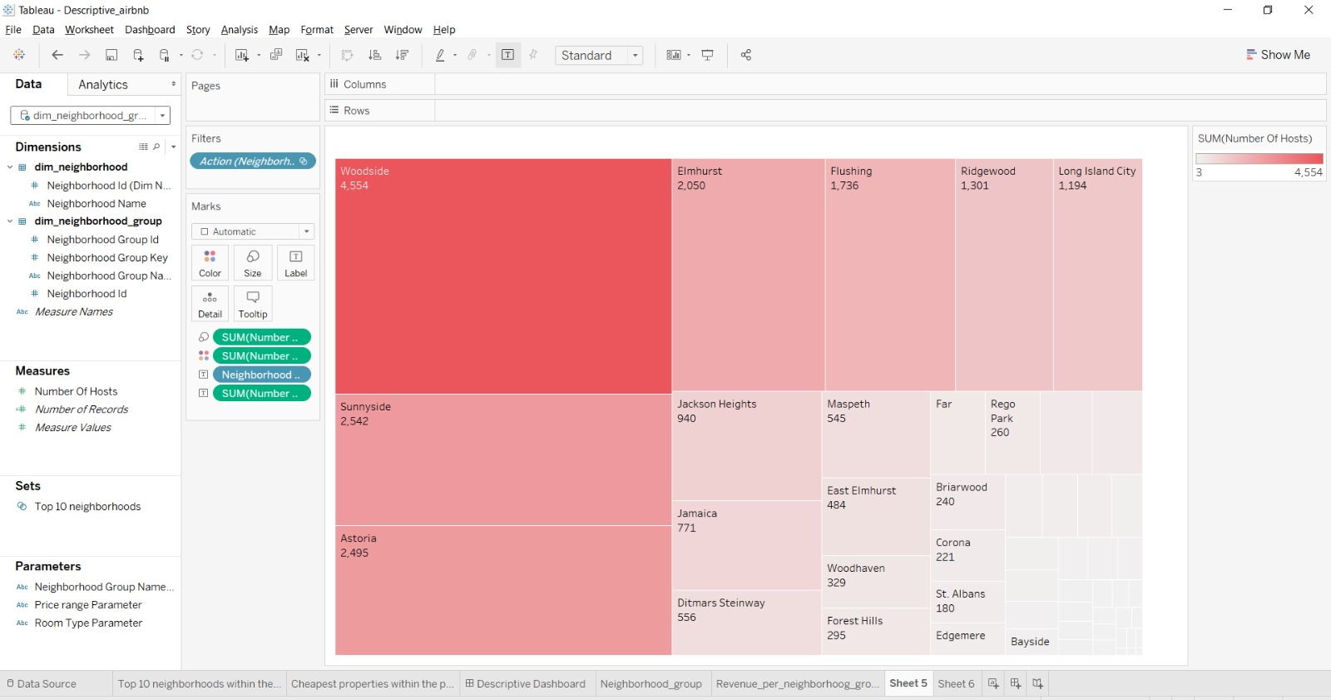

Slide 27
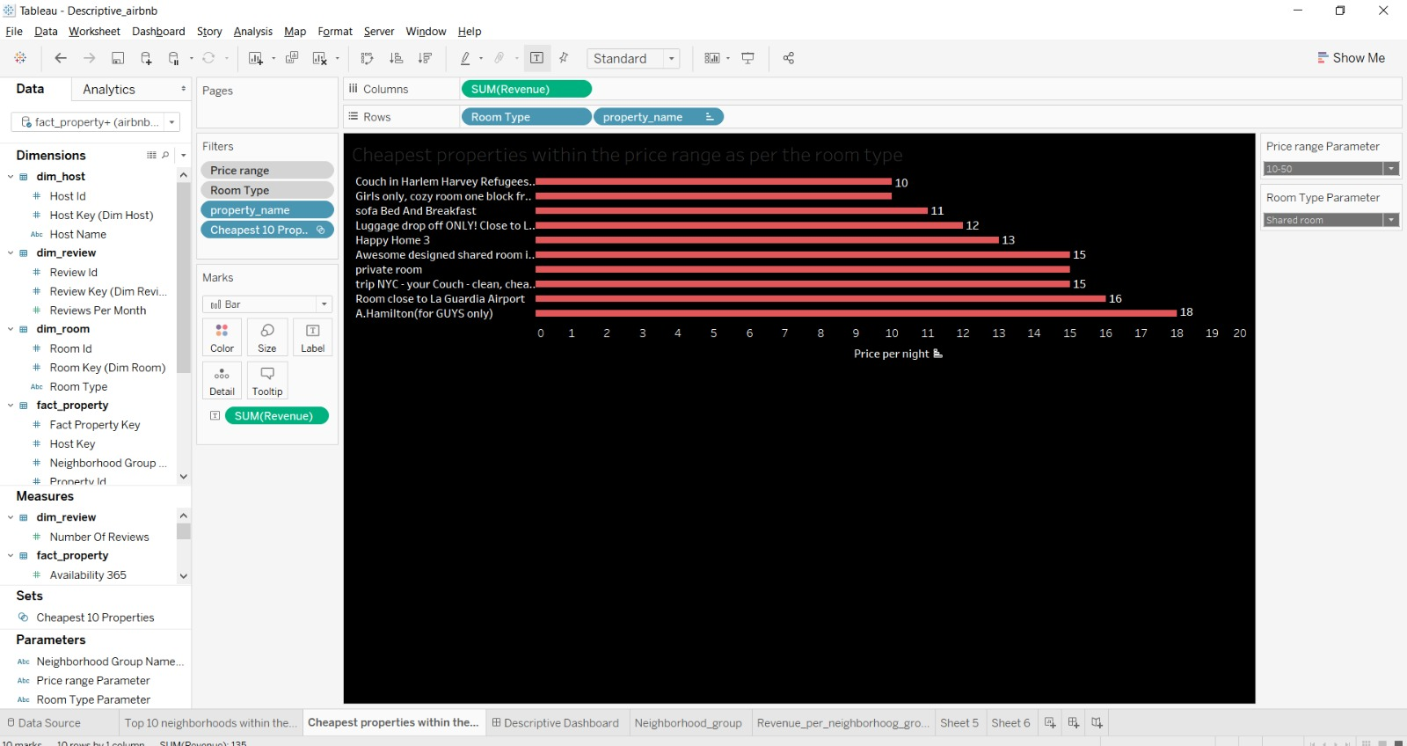

Slide 28
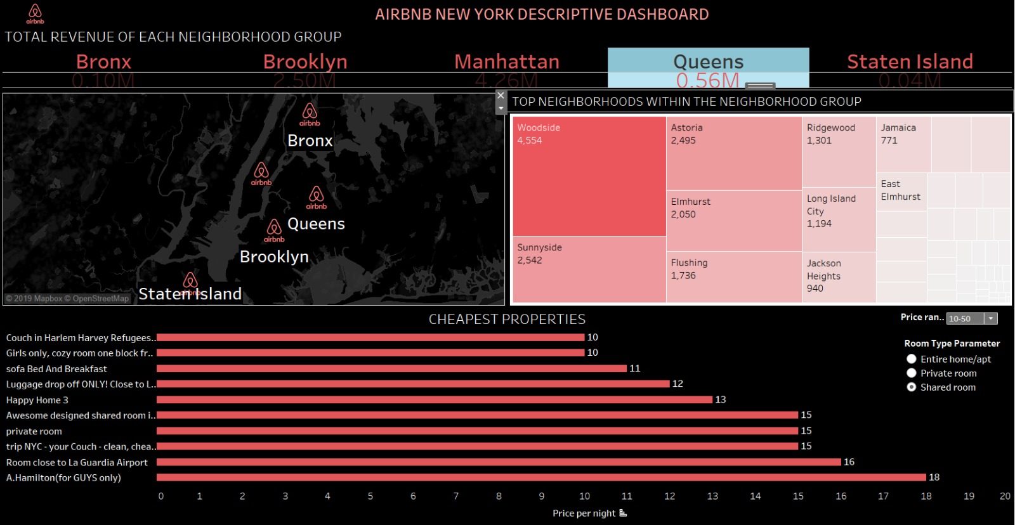

Slide 29
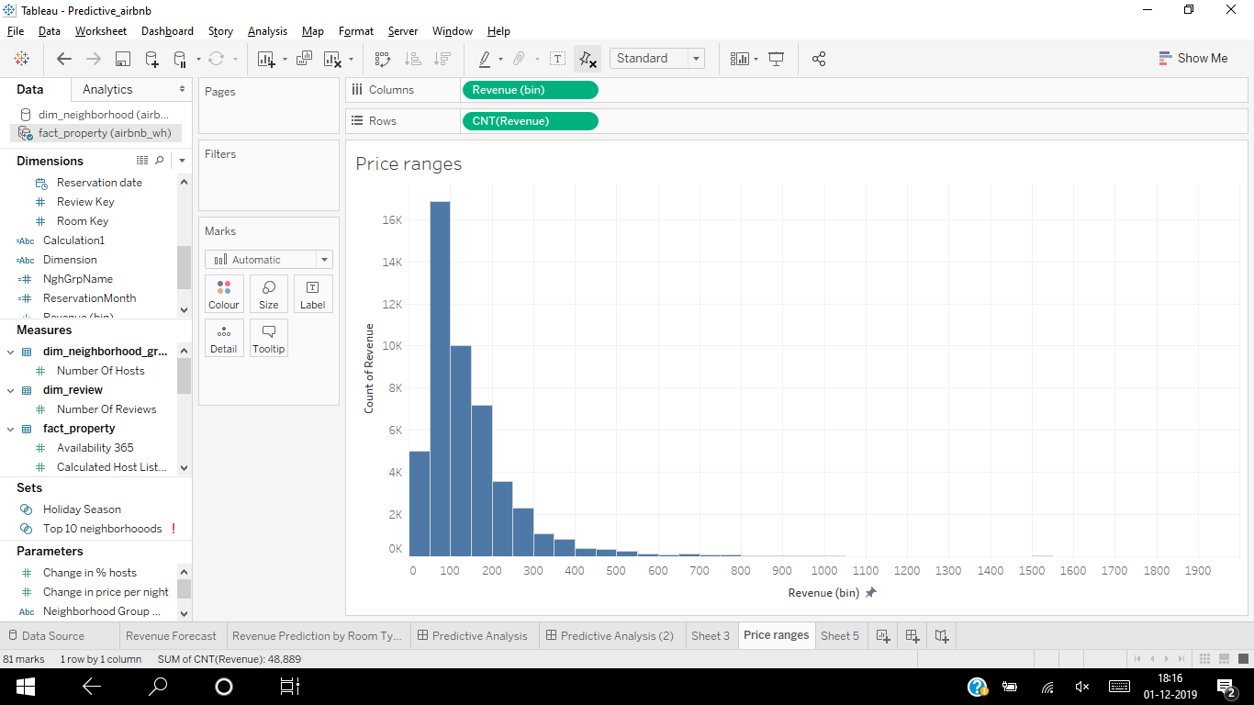

Slide 30
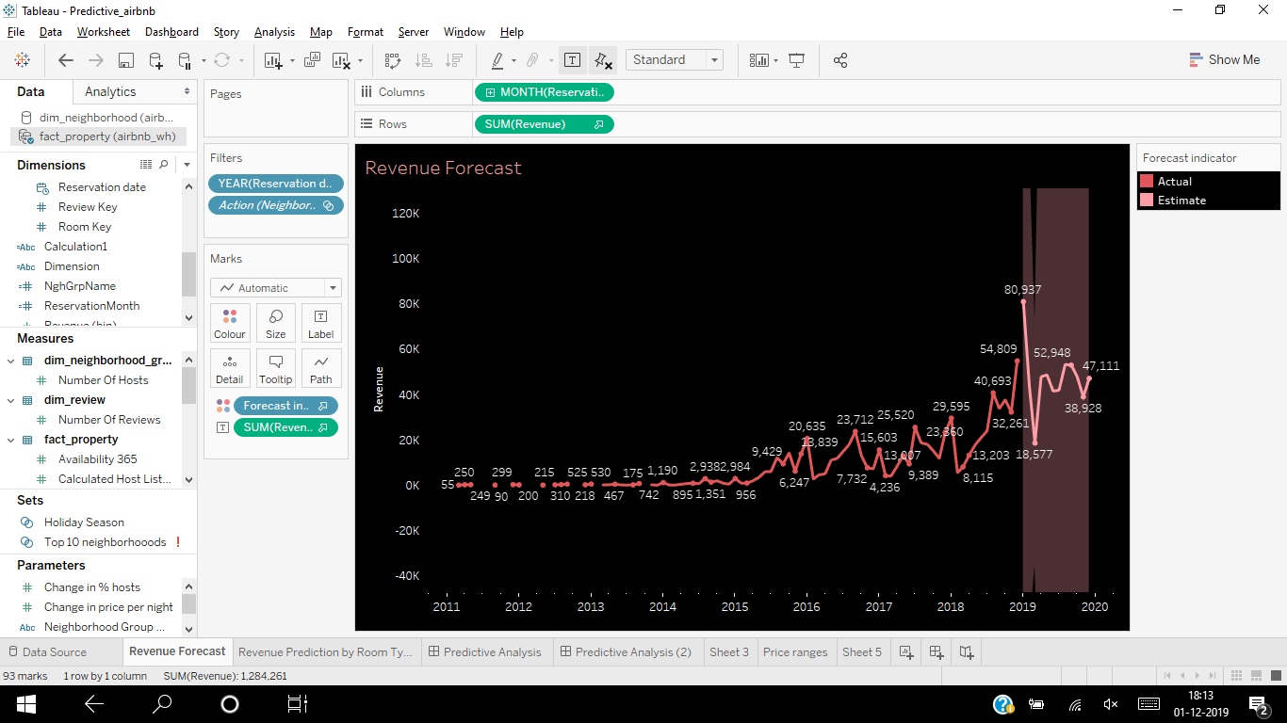

Slide 31
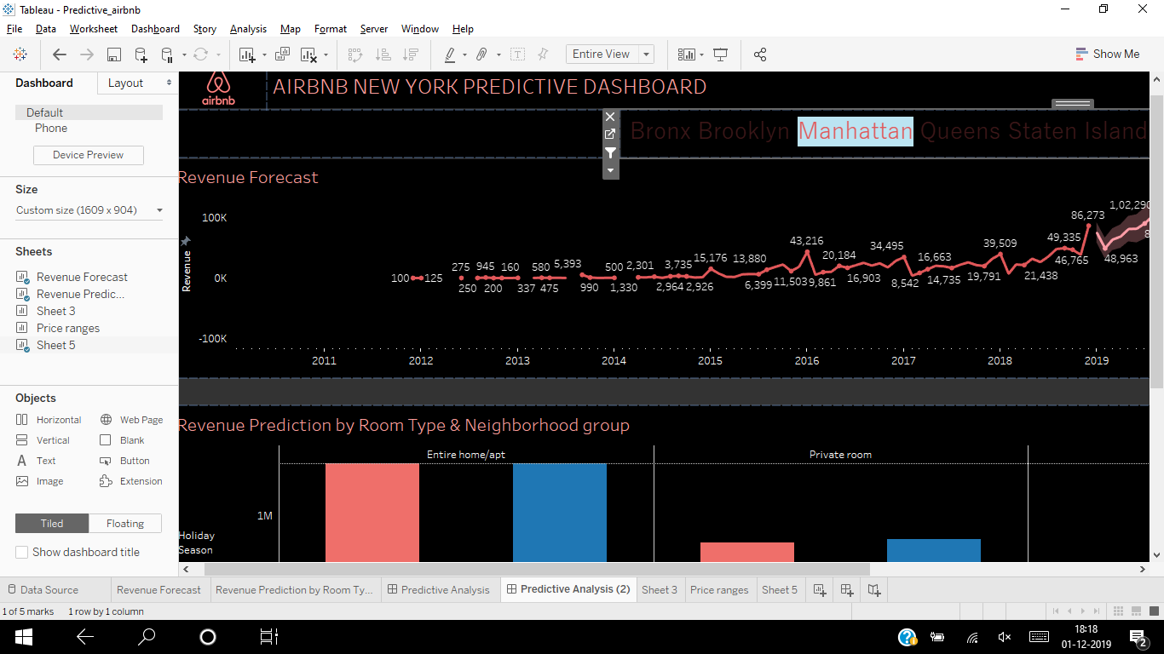

Slide 32
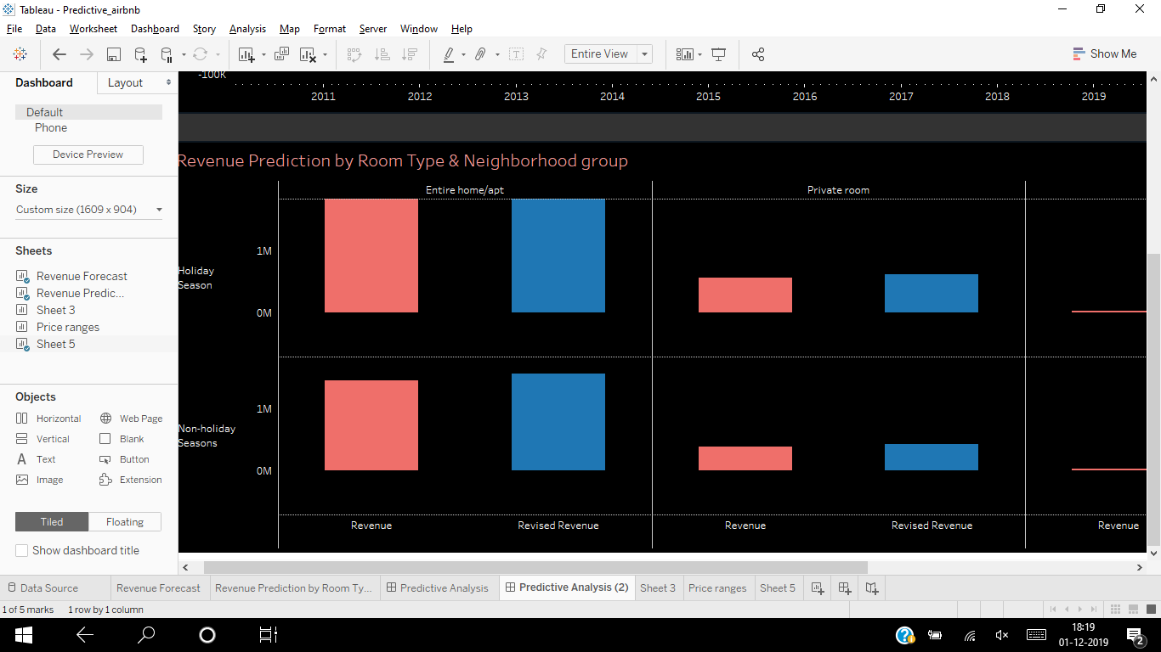

Slide 33
Thank You!
Notes:
Everyone

